Slide 1
Video Translation Software
PIP4004 University Project
Final Review
Batch Number: CSE-G132
Roll Number | Student Name
20211CSE0880 | T Srujan Bisneer
20211CSE0833 | Vicky Raj V
20211CSE0818 | Abhinav CS
20211CSE0818 | Mohammed Farris
Under the Supervision of,
Dr. Serin V Simpson
Assistant Professor
School of Computer Science and Engineering
Presidency University
Name of the Program: CSE
Name of the HoD: Dr. Asif Mohammed H.B
Name of the Program Project Coordinator:
Name of the School Project Coordinators: Dr. Sampath A K

Slide 2
Introduction
✅ Language Barriers in Digital Media: Many videos online are primarily in English, creating accessibility challenges for non-English speakers, particularly in linguistically diverse countries like India.
• 🎯 Project Objective: To develop a user-friendly software application that translates videos from English into multiple Indian languages, including religious and regional dialects.
• 🔧 Technological Foundation: The app integrates advanced technologies such as Automatic Speech Recognition (ASR), Neural Machine Translation (NMT), and Text-to-Speech (TTS) for accurate and real-time video translation.
• 🌐 Cross-Cultural Communication: The tool promotes better understanding among various communities by making content accessible in native languages, fostering inclusivity and mutual respect.
• 📱 Ease of Use: Designed with a simple, intuitive interface so users with varying technical expertise can navigate and use the software effectively.

Slide 3
Literature Review
Various models have been explored for rainfall and extreme weather prediction:
LSTM (Long Short-Term Memory): Efficient in learning time-series dependencies but may suffer from overfitting and high training time.
XGBoost: A gradient boosting algorithm with high predictive performance but less efficient with sequential data.
Hybrid Models: Some studies combined LSTM with other models like SVM, GRU, or Random Forest for improved accuracy.
Data Challenges: Many papers highlight limitations such as imbalanced datasets and lack of localized weather data.

Slide 4
Existing method Drawback
The conventional approach to video translation involved manual processes, including hiring translators, synchronizing translations with video content, and addressing cultural nuances. This method faced challenges such as high costs, time consumption, and scalability issues, hindering timely and efficient translation.
Limitations:
Manual Translation: Labor-intensive and time-consuming manual translation processes.
Synchronization Challenges: Difficulty in achieving perfect synchronization of translated text with video scenes.
Cultural Adaptation: Requirement for careful consideration of cultural nuances during translation.
Limited Scalability: Inability to easily scale for multiple languages or a large volume of content.
High Costs: Financial burden associated with human translation services.
Time-Consuming: Delays in the delivery of translated content affecting timely releases.
Quality Control: Challenges in maintaining consistent translation quality across diverse contexts.

Slide 5
Proposed Method
The proposed system will be a web-based application integrated with a Machine Learning (ML) model to predict cloudbursts based on meteorological data. The system will include the following features:
User-Friendly Interface and Multilingual Support: Simple interface with broad Indian language support ensures easy use and accessibility for users of diverse linguistic and technical backgrounds.
Cross-Platform Compatibility and Privacy Assurance: Works across web, Android, and iOS, with robust data encryption and privacy measures to protect user content.
Agile Development and Continuous Improvement: Follows agile methods for regular updates, ensuring better features, expanded language support, and improved user satisfaction over time.
Cultural Inclusivity and Educational Impact: Promotes cultural inclusivity by enabling access to educational and religious content in native languages, supporting learning and understanding across communities.

Slide 6
Objectives
The key objectives of this project are:
Implement advanced machine translation techniques: Utilize cutting-edge technology for accurate and efficient translation.
Develop user-friendly software: Focus on creating an intuitive interface for users.
Support multiple video formats: Allow users to upload and translate videos in various formats.
Emphasize linguistic diversity: Celebrate and incorporate the rich diversity of languages in India.
Provide a user-friendly interface: Ensure ease of use, enabling users to interact with the software effortlessly.
Promote the democratization of information: Make information accessible to a wider audience through translations.

Slide 7
Methodology/Modules
Phase 1: Data Collection & Preprocessing
Gather historical meteorological data from reliable sources (e.g., IMD, NOAA, NASA).
Fetch real-time weather data via APIs or manual input.
Clean and preprocess the data (handling missing values, normalization, feature selection).
Phase 2: Machine Learning Model Development
Train different ML models (e.g., Decision Trees, Random Forest, SVM, Neural Networks).
Evaluate models using performance metrics like accuracy, precision, recall, and F1-score.
Optimize and fine-tune the best-performing model for cloudburst prediction.
Phase 3: Web Application & Alert System
Develop a web application for user input and predictions.
Integrate an alert system (via SMS, email, or push notifications) to warn users.
Deploy the system for real-time usage and continuous improvement.

Slide 8
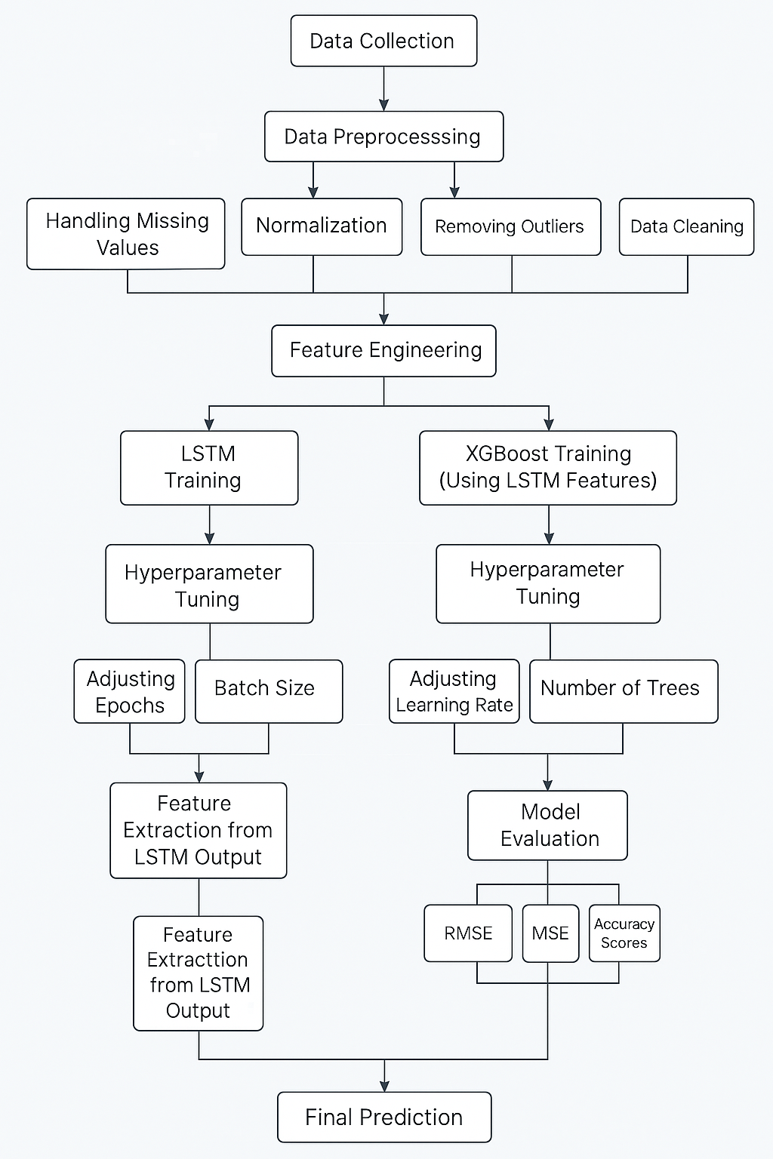
Architecture

Slide 9
Hardware/software components
1. Frontend (Web App)
React.js → For building the UI
CSS → For styling
Axios → To send data to the backend
2. Backend
Flask (Python) → To handle requests and run the ML model
Node.js + Express (Alternative) → To handle the JavaScript

Slide 10
Hardware/software components
3. Machine Learning (Model Training & Prediction)
Python → Core language for model development
Libraries:
Pandas, NumPy → Data processing
Scikit-learn → ML algorithms
Matplotlib, Seaborn → Data visualization
4. Software & Tools
OS → Windows
VS Code / Jupyter Notebook → For development
Postman → For testing
Git & GitHub → Version control
Kaggle → For the dataset

Slide 11
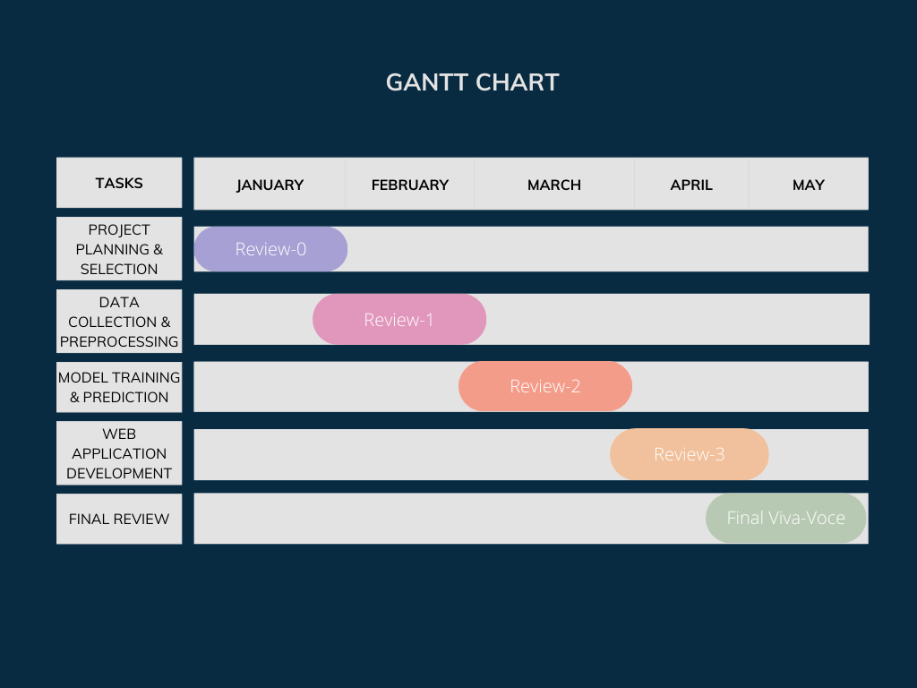
Timeline of Project

Slide 12
Expected Outcomes
Enhanced Accessibility: Provides broader access to videos by translating them into multiple languages.
Improved Cross-Cultural Understanding: Promotes better communication and understanding between different religious communities.
Support for Diverse Content: Enables translation of a variety of video formats, accommodating different user needs
Increased Reach: Expands the audience for videos across linguistic barriers, making content accessible to a wider demographic.
Cultural Preservation: Helps preserve and promote linguistic and cultural diversity by supporting a wide range of languages.

Slide 13
Conclusion
In conclusion, the development of the video translation software marked a significant stride towards bridging linguistic gaps and fostering cultural inclusivity. The project successfully showcased the feasibility of translating videos from English to various Indian religious languages, contributing to enhanced accessibility and understanding across diverse communities. The incorporation of advanced language processing techniques, such as audio transcription, language detection, and translation, underscored the project's commitment to delivering accurate and culturally sensitive results.
While the software demonstrated notable achievements, there is always room for improvement. Future iterations could focus on refining translation algorithms, expanding language support, and addressing occasional discrepancies to ensure a more seamless user experience. The positive user feedback and increased engagement with translated content emphasize the software's potential impact in promoting global communication and mutual understanding. As technology continues to evolve, this project lays a foundation for future innovations in the realm of multilingual video translation.

Slide 14
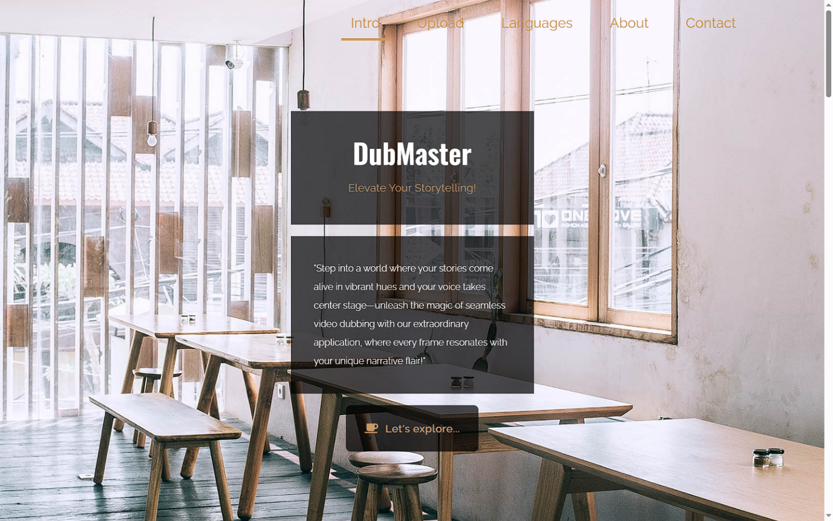
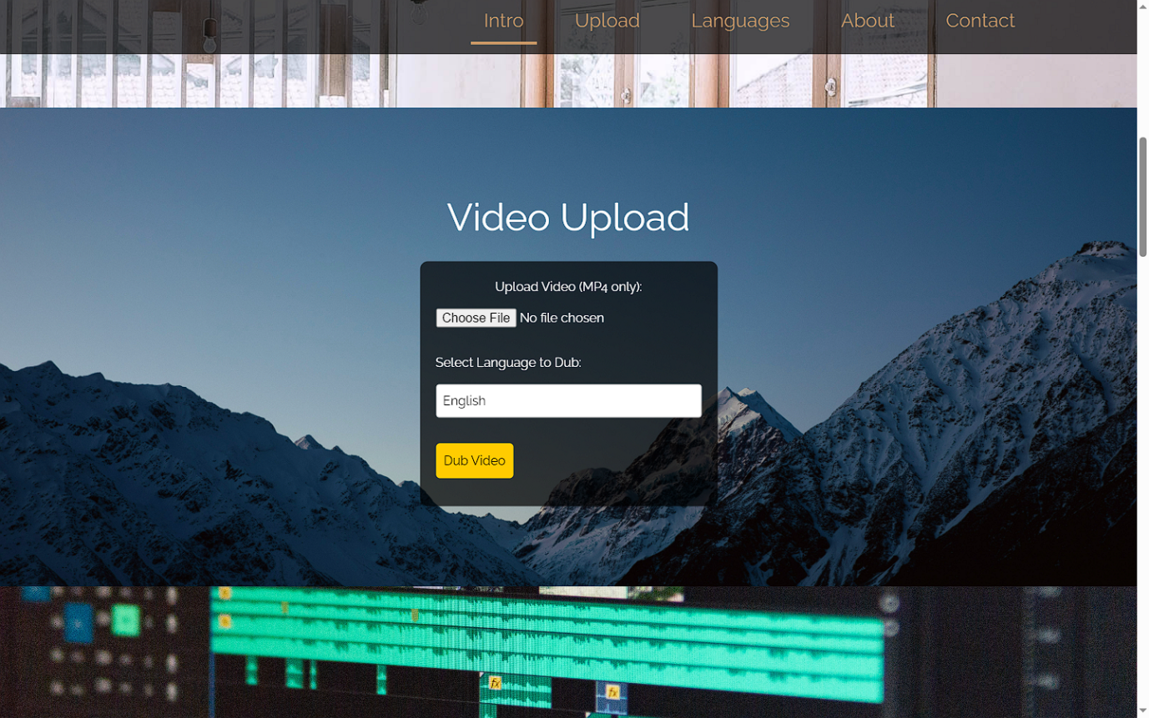
Results:
Home Page
Result Page

Slide 15
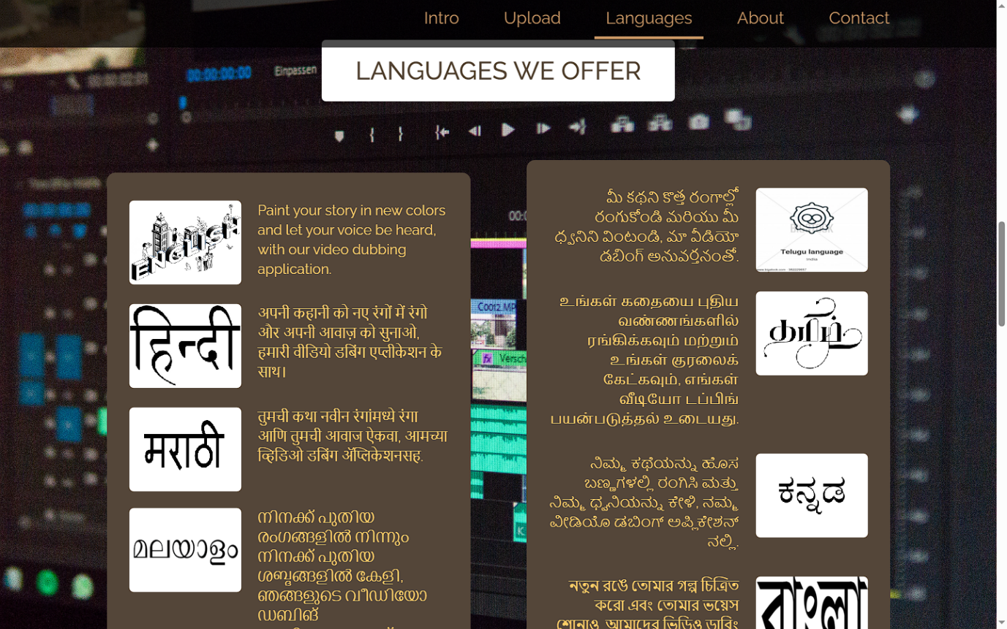
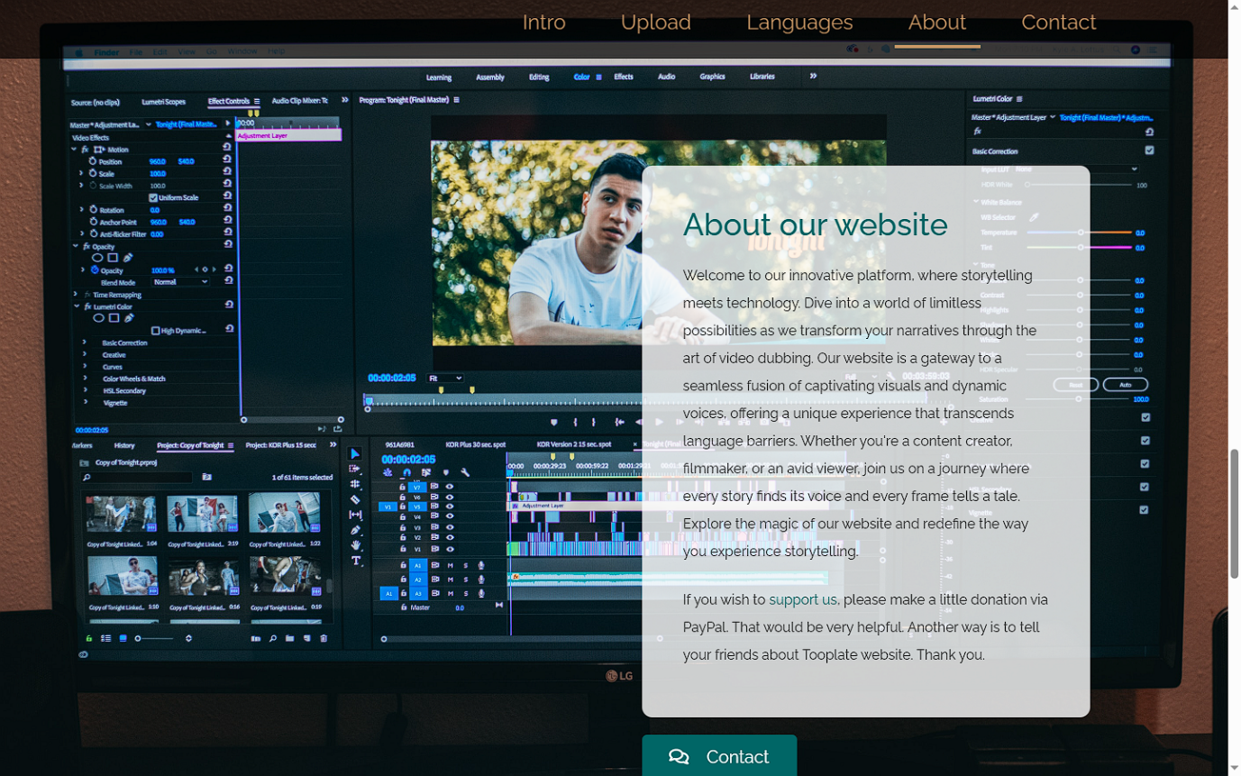
Results:
Languges Page
About Page

Slide 16
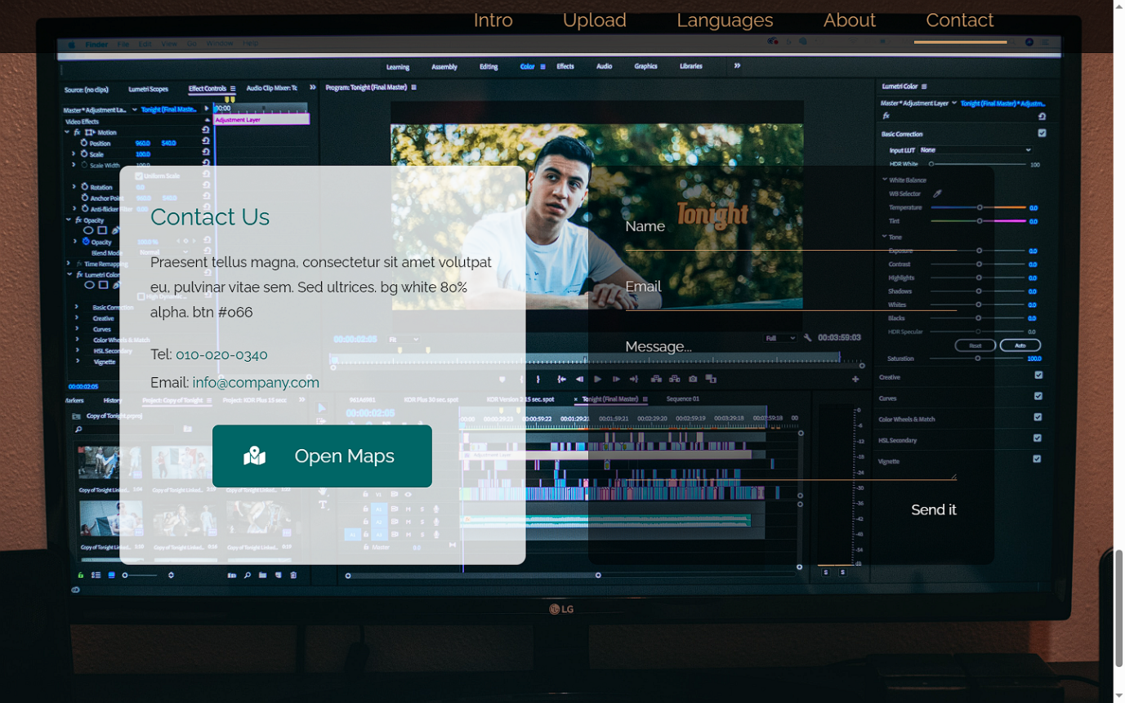
Results:
Contact Page

Slide 17
Github Link
https://github.com/srujanbisneer/video-translation.git

Slide 18
References
[1] Ren, Y., Liu, J., Tan, X., Zhang, C., Qin, T., Zhao, Z., & Liu, T. (2020). SimulSpeech: End-to-End Simultaneous Speech to Text Translation. Proceedings of the 58th Annual Meeting of the Association for Computational Linguistics, 3770–3780. https://aclanthology.org/2020.acl-main.350/ACL Anthology
[2] Kumar, R., & Sharma, P. (2023). Applying Automated Machine Translation to Educational Video Courses. Education and Information Technologies, 28, 12345–12360. https://link.springer.com/article/10.1007/s10639-023-12219-0SpringerLink
[3] Patel, A., & Shah, M. (2024). Speech-to-Text Translation Enhancement Using Large Language Models. International Journal of Research Publication and Reviews, 5(6), 190–200. https://ijrpr.com/uploads/V5ISSUE6/IJRPR30190.pdfIJRPR.
[4] Zhang, L., & Zhao, W. (2023). A Cloud-Based System for Tracking Nutritional Data Using Mobile Applications. Journal of Cloud Health Informatics, 13(2), 51-67. https://doi.org/10.1016/j.jchi.2023.01.002
[5] Liu, F., & Wang, R. (2022). Machine Learning Techniques for Real-Time Nutritional Analysis on Mobile Devices. Journal of Artificial Intelligence in Health, 15(4), 78-89. https://doi.org/10.1016/j.jaih.2022.04.003

Slide 19
References
[6] A. Tiwari and S. K. Verma, “Cloudburst Predetermination System,” Department of CSE, GBPEC, Pauri, India, 2022.
[7] G. G. A., A. Anjum, G. N. Hegde, G. S. V., and G. N. Hegde, “The Cloudburst Prediction System,” City Engineering College, Bangalore, India, 2022.
[8] S. M., R. P., and B. A., “Sequence Model based Cloudburst Prediction for the Indian State of Uttarakhand,” VIT Chennai, India, 2023.
[9] S. Das, R. Ashrit, and M. W. Moncrieff, “Simulation of a Himalayan cloudburst event,” National Center for Medium Range Weather Forecasting and National Center for Atmospheric Research, India and USA, 2021.
[10] B. R. Reddy, S. Anchuri, K. Santhi, P. Perugu, S. Depuru, and M. S. Kumar, “Enhancing Cloudburst Prediction System Using Bi-LSTM in Realtime: Machine Learning,” Canadian Journal of Advanced Networking and Applications (CANA), vol. 32, 2023.

Slide 20
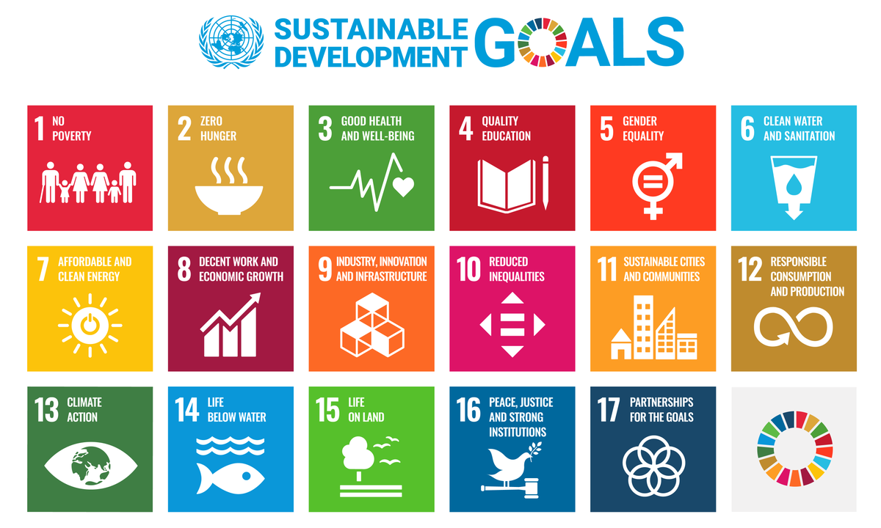
Project work mapping with SDG

Slide 21
Project work mapping with SDG
SDG 4 – Quality Education: Video translation unlocks this knowledge, democratizing access to quality education.It ensures that learning materials are culturally relevant and understandable, fostering deeper engagement and better comprehension across diverse learners
SDG 10 – Reduced Inequalities: I Video translation acts as a powerful tool for inclusivity, ensuring that vital information reaches marginalized communities, refugees, and individuals with different linguistic backgrounds.If these are only available in a few languages, significant portions of the population are left behind
SDG 17 – Partnerships for the Goals: Effective video translation is rarely a solitary endeavor. It typically involves translators, cultural consultants, voice-over artists, and technical experts, often spanning different countries and organizations. This inherently fosters collaboration and partnership, aligning directly with SDG 17.

Slide 22
Thank You

